Slide 1

Solar Data
Browse and Obtain

Slide 2
Outline
Data/instrument overview
Online resources for browsing and acquiring data
Basic Data Prep

Slide 3
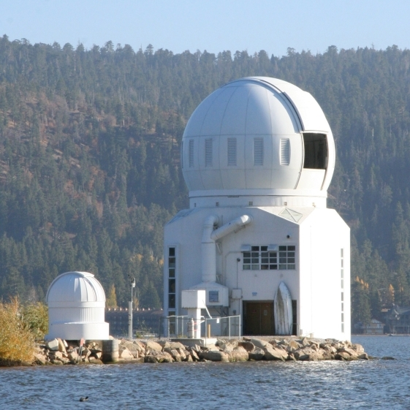
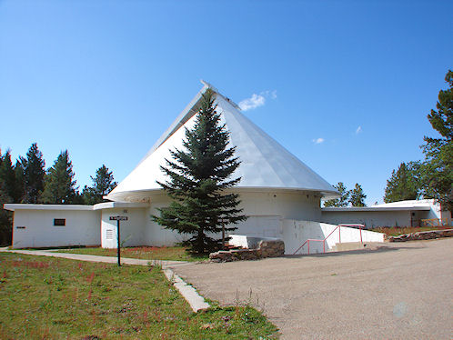
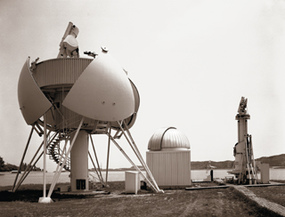
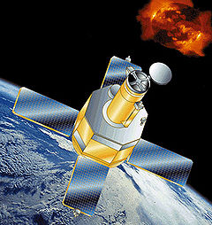
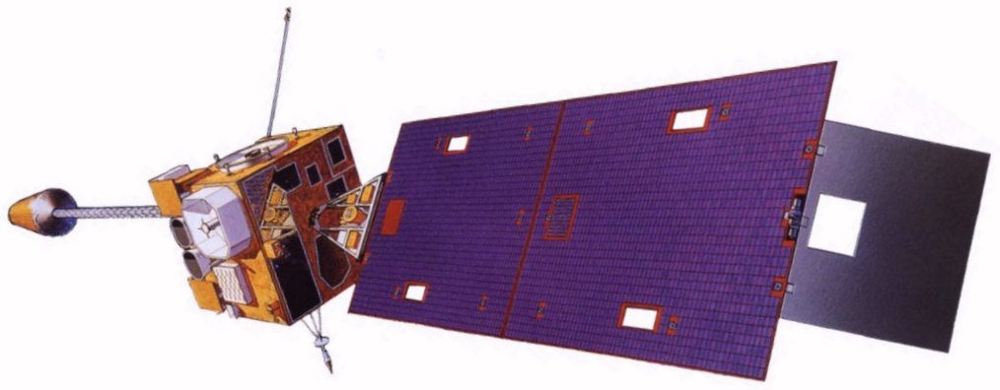
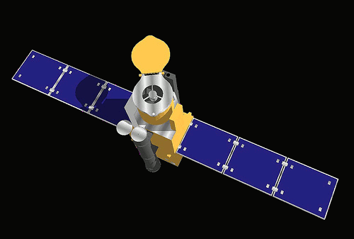
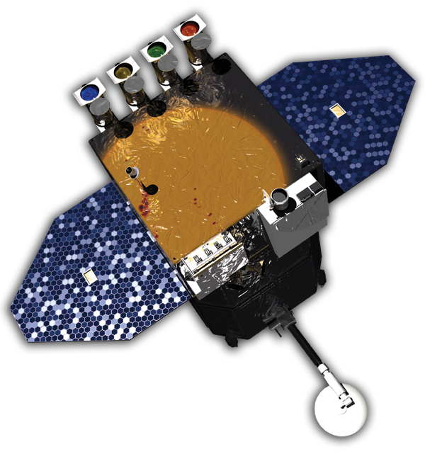
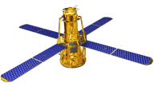
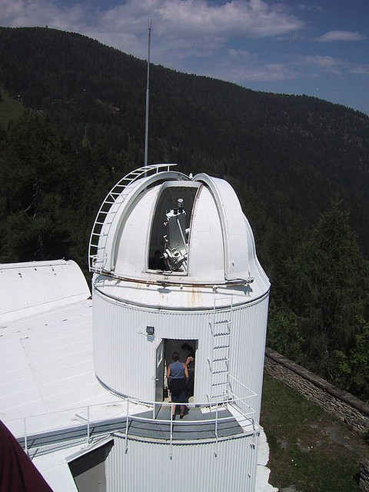
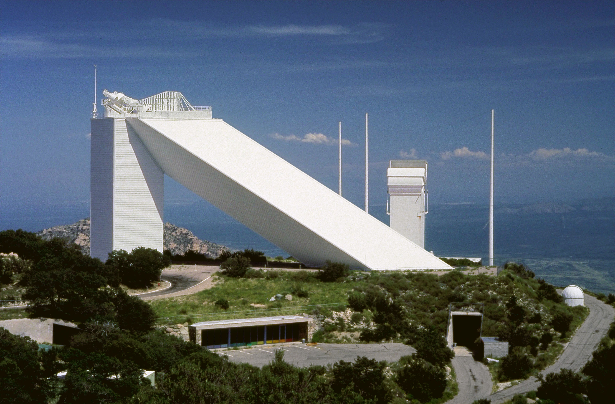
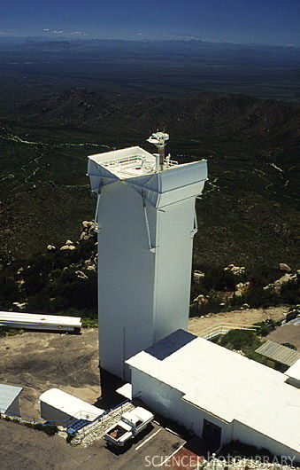
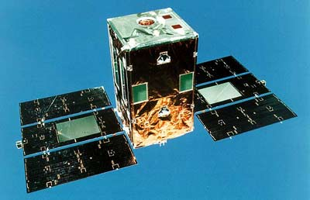
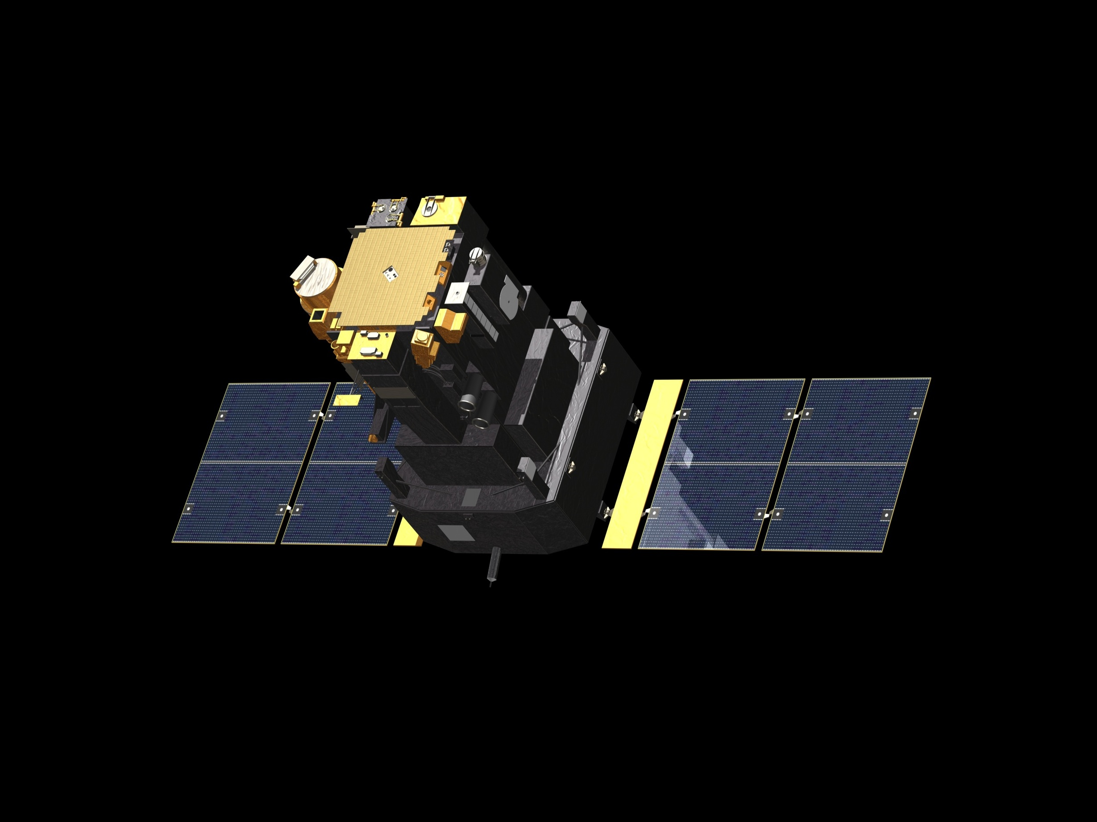
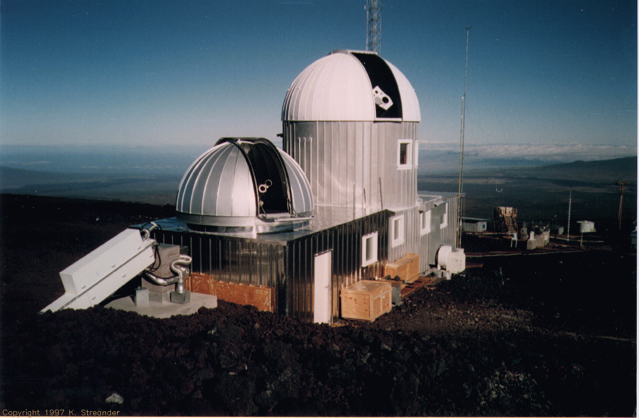
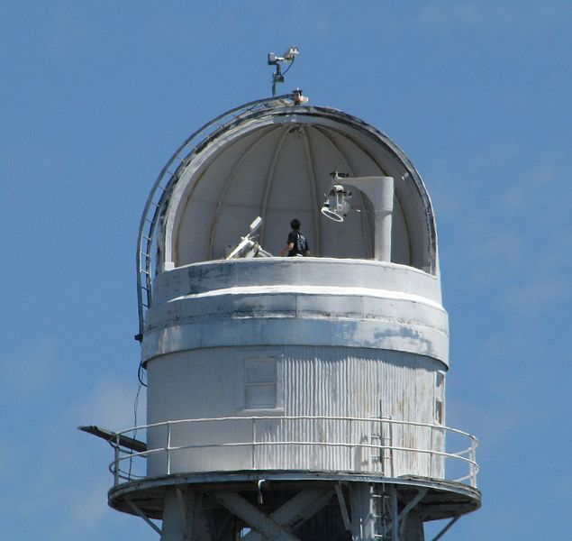
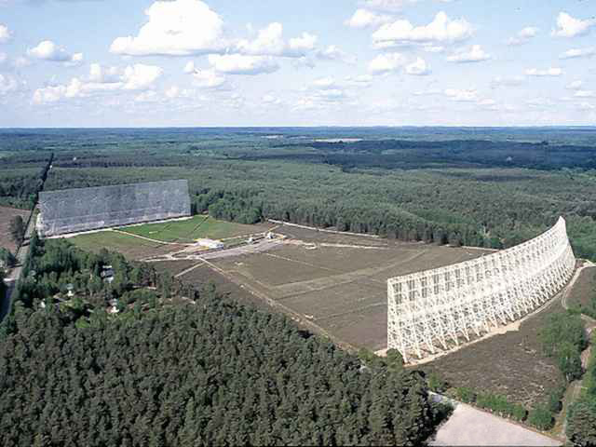
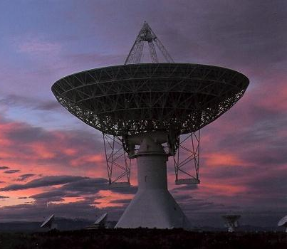
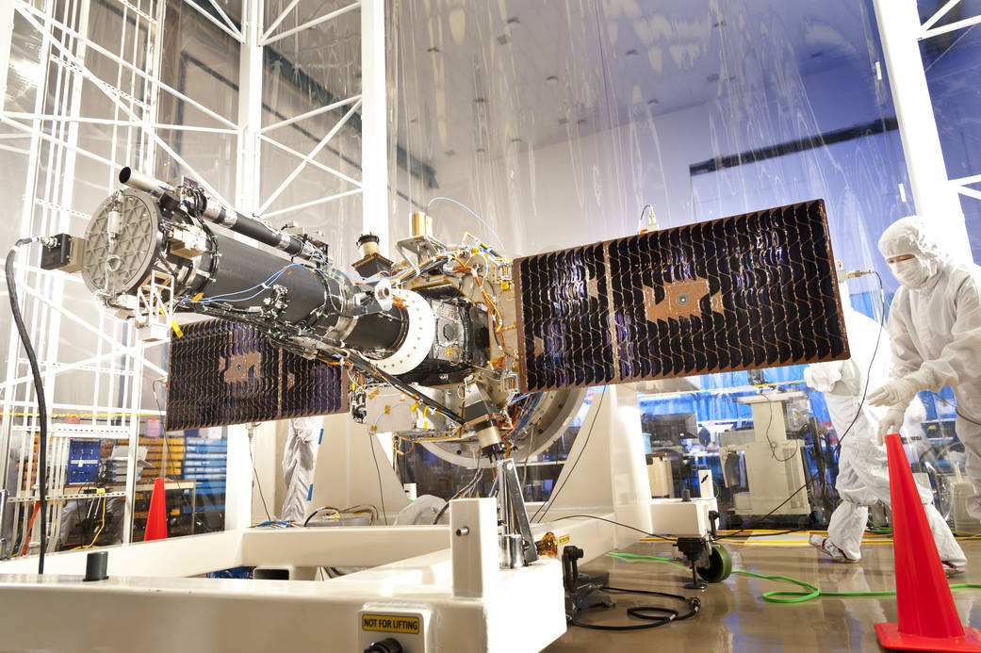
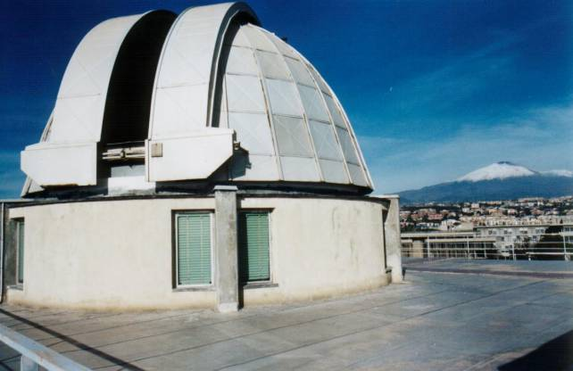
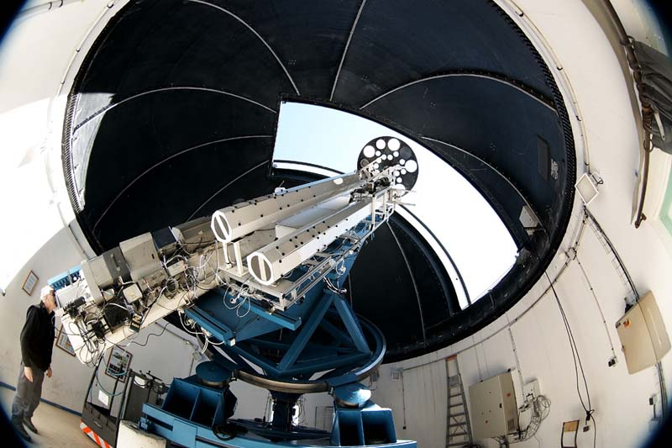
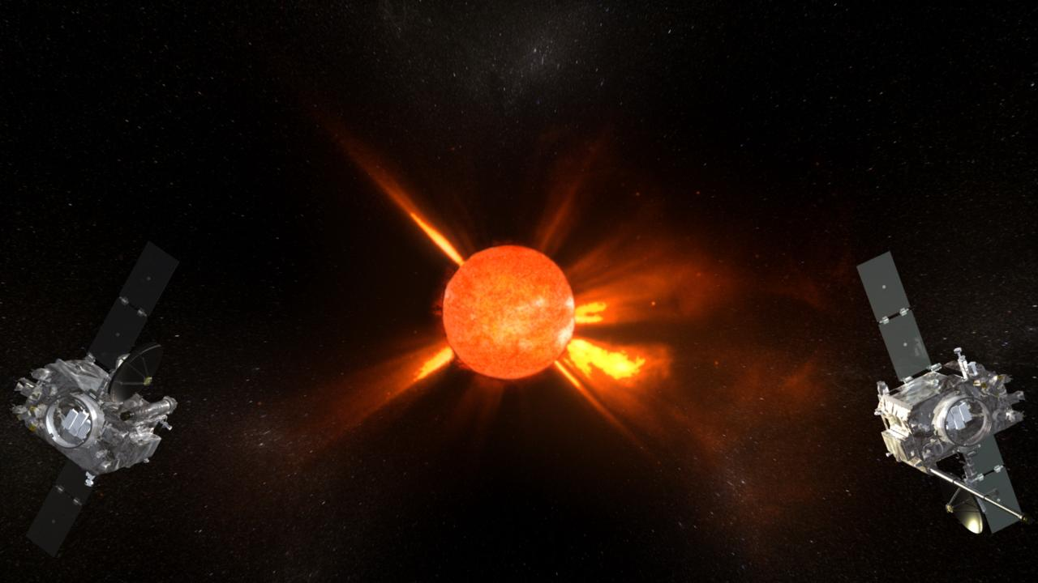
Big Bear Solar Obs.
Evans Solar Telescope
San Fernando Observatory
TRACE
GOES – 14,15
Hinode (Solar B)
SDO
RHESSI
Kanzelhöhe Solar Obs.
McMath Solar Telescope
Vacuum Tower Telescope
YOHKOH (Solar A)
SOHO
Mauna Loa Solar Observatory
Mt Wilson Solar Observatory
Nançay Radio Observatory
Osservatorio Astrofisico di Catania
Observatoire du Pic du Midi
Owens Valley Radio Observatory
STEREO A & B
IRIS

Slide 4
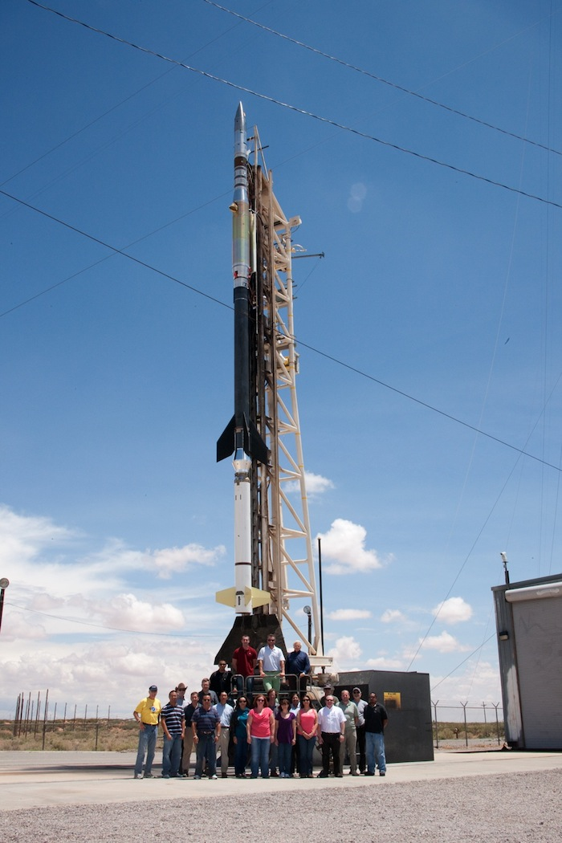
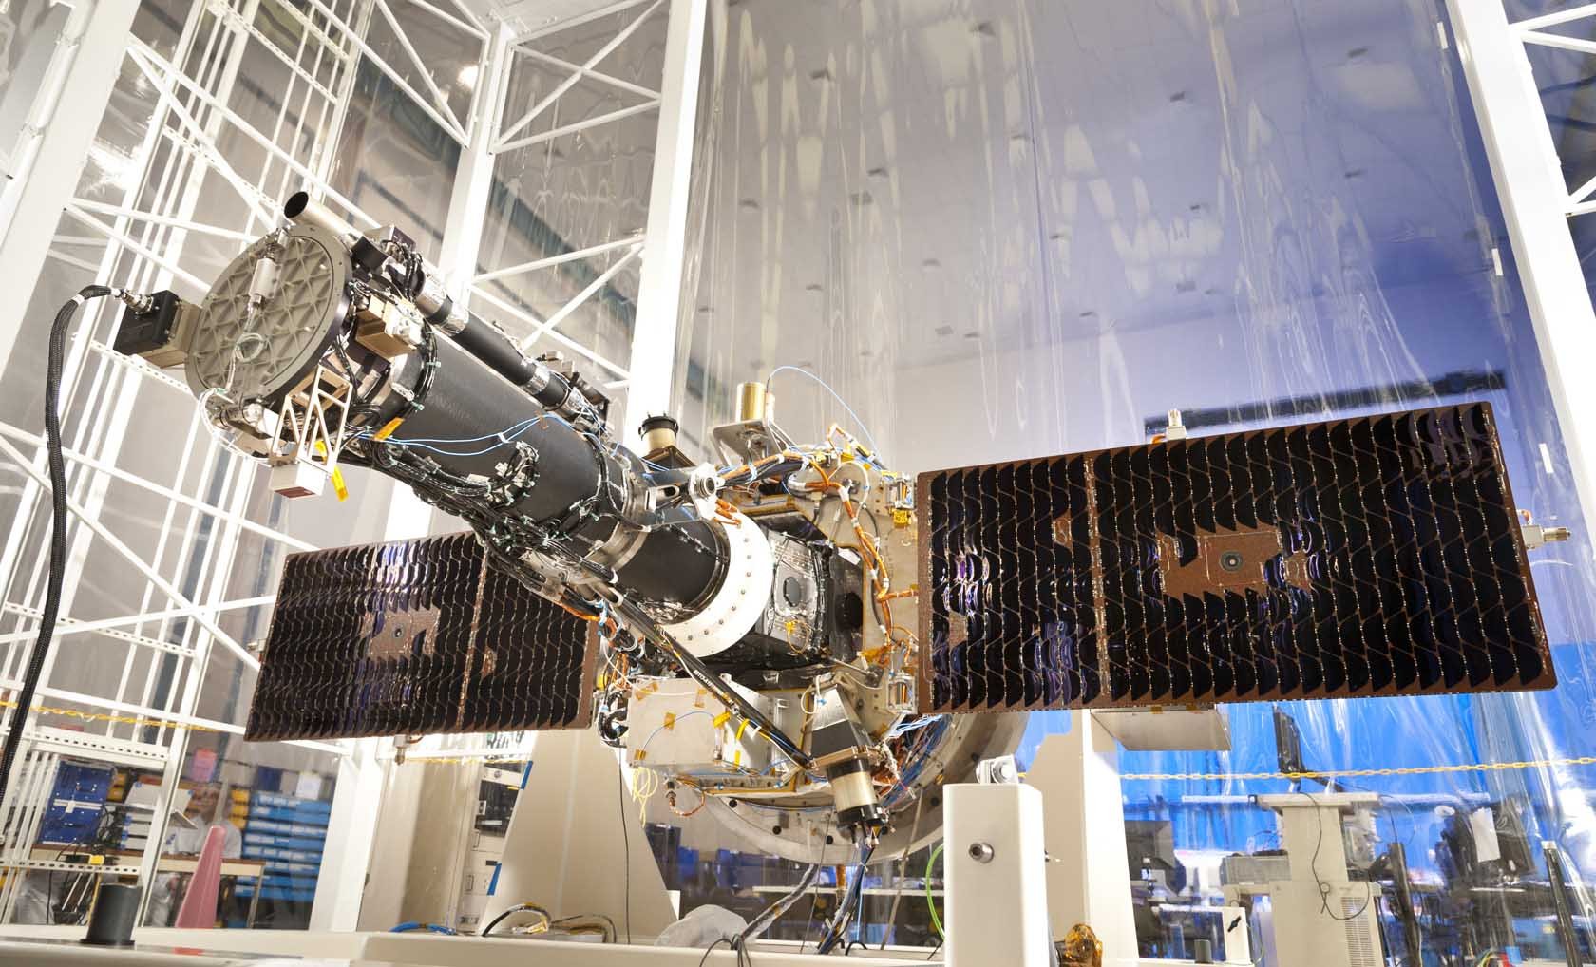
Big Bear Solar Obs.
Evans Solar Telescope
San Fernando Observatory
TRACE
GOES – 12
Hinode (Solar B)
SDO
RHESSI
Kanzelhöhe Solar Obs.
McMath Solar Telescope
Vacuum Tower Telescope
YOHKOH (Solar A)
SOHO
Mauna Loa Solar Observatory
Mt Wilson Solar Observatory
Nançay Radio Observatory
Osservatorio Astrofisico di Catania
Observatoire du Pic du Midi
Owens Valley Radio Observatory
STEREO A & B

Slide 5
Big Bear Solar Obs.
Evans Solar Telescope
San Fernando Observatory
TRACE
GOES – 12
Hinode (Solar B)
SDO
RHESSI
Kanzelhöhe Solar Obs.
McMath Solar Telescope
Vacuum Tower Telescope
YOHKOH (Solar A)
SOHO
Mauna Loa Solar Observatory
Mt Wilson Solar Observatory
Nançay Radio Observatory
✗
Osservatorio Astrofisico di Catania
Observatoire du Pic du Midi
Owens Valley Radio Observatory
STEREO A & B

Slide 6
Solar Observables and Inferables
Observe
Intensity (Imaging: Hinode-XRT, IRIS, SDO/AIA)
Line Strengths (Spectroscopy: Hinode-EIS, IRIS, Ground based)
LOS Velocity (Doppler: Hinode-EIS, IRIS, SDO/HMI)
Polarization Vector (SDO/HMI)
Calculate
LoS Magnetic Field (Zeeman)
Vector Magnetic Field (LoS MF + Polarization)
Wave Power (acoustic-gravity waves)
Composition (Spectroscopy)
Morphology/Density (Intensity)

Slide 7
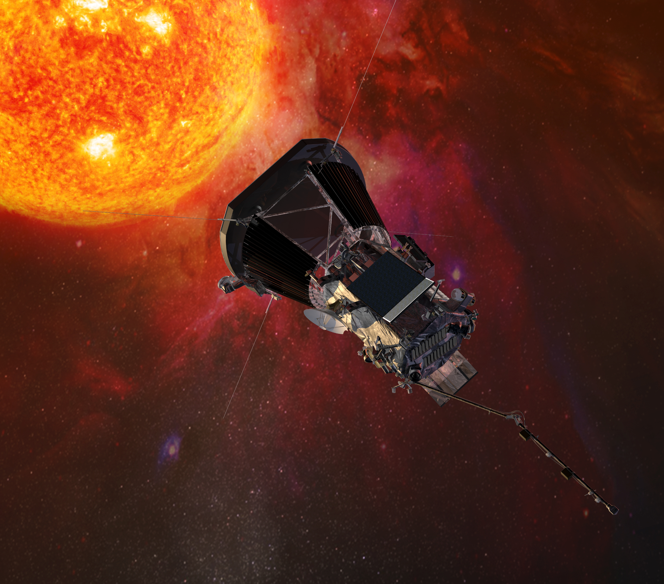
Solar Observables Coming Soon
Parker Solar Probe
9 Solar Radii
Number Density
Particle Flux
Particle Velocity
Thermal Velocity

Slide 8
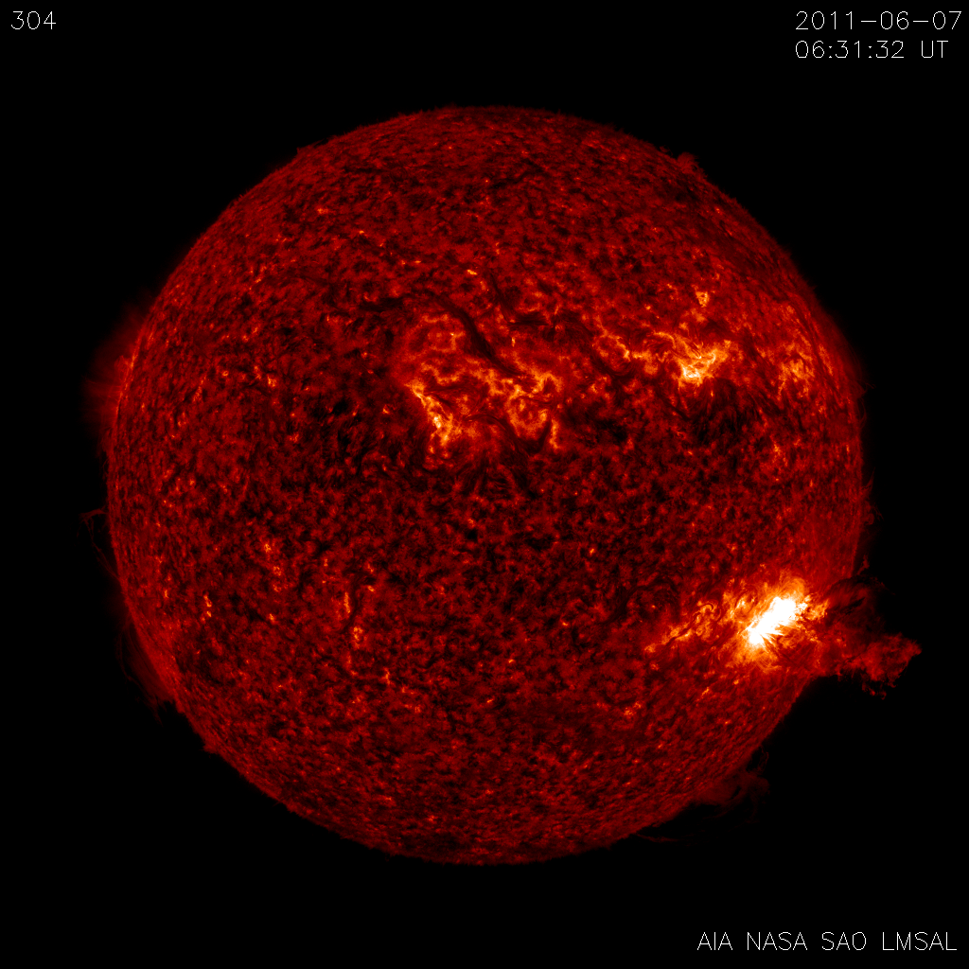
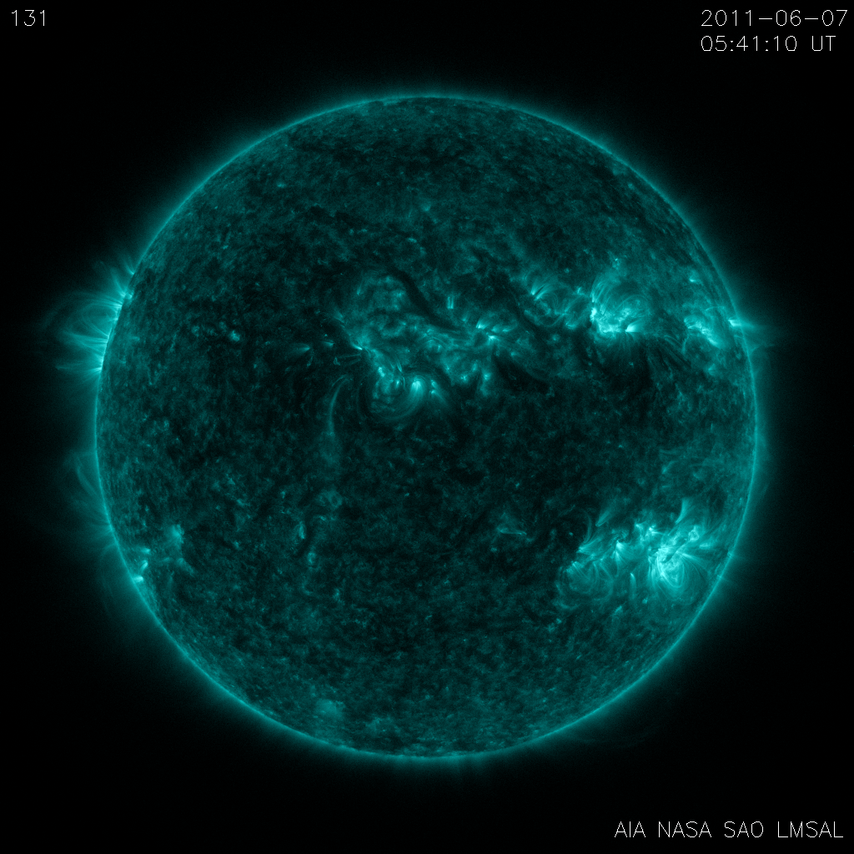
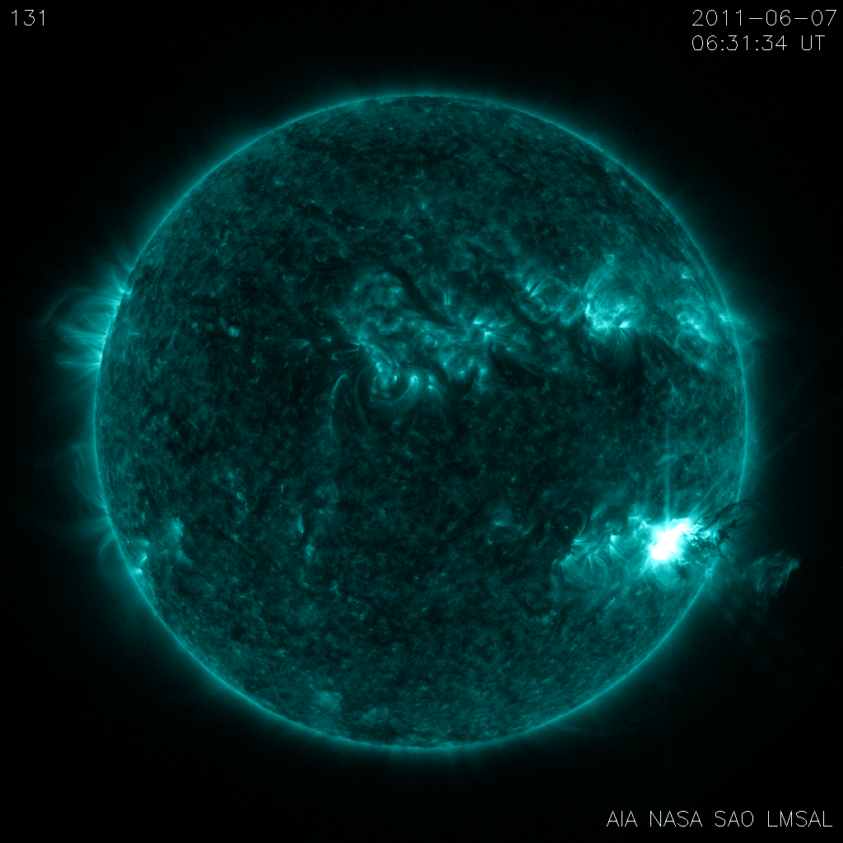
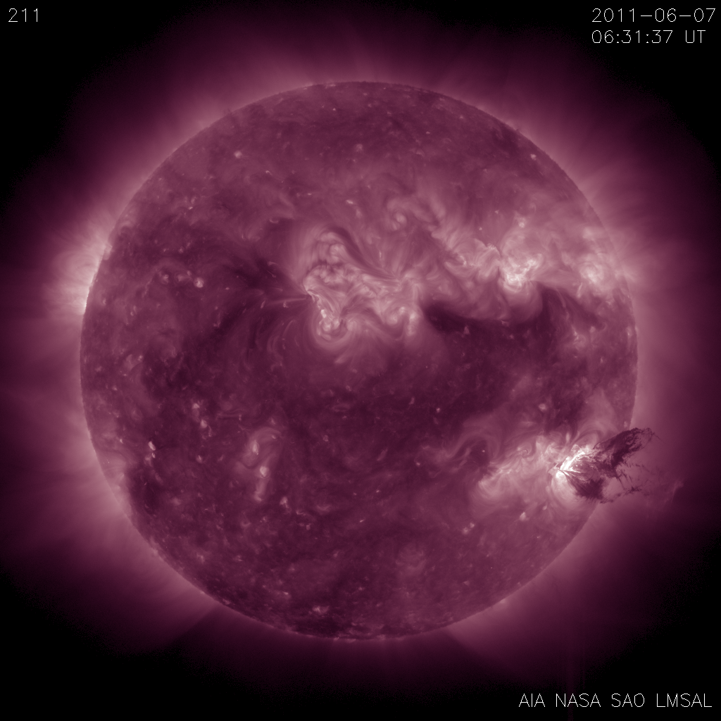
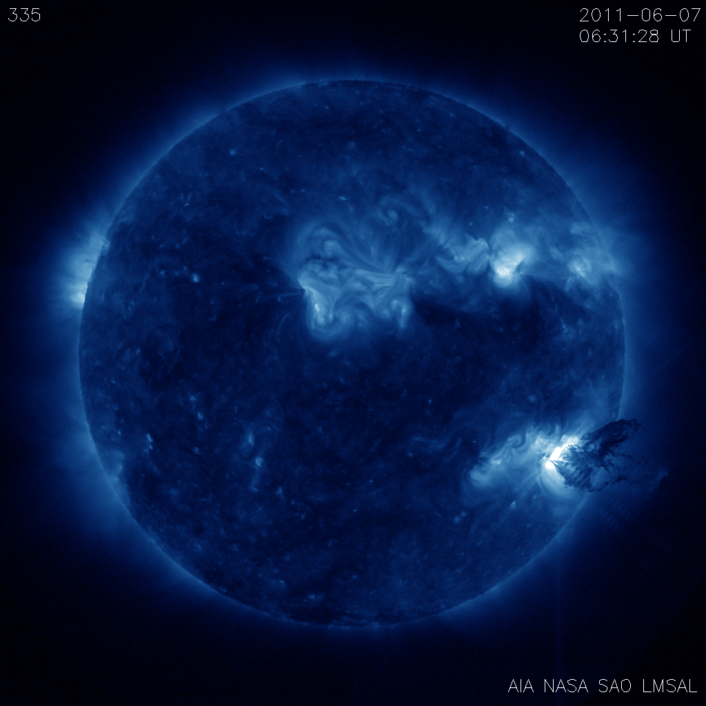
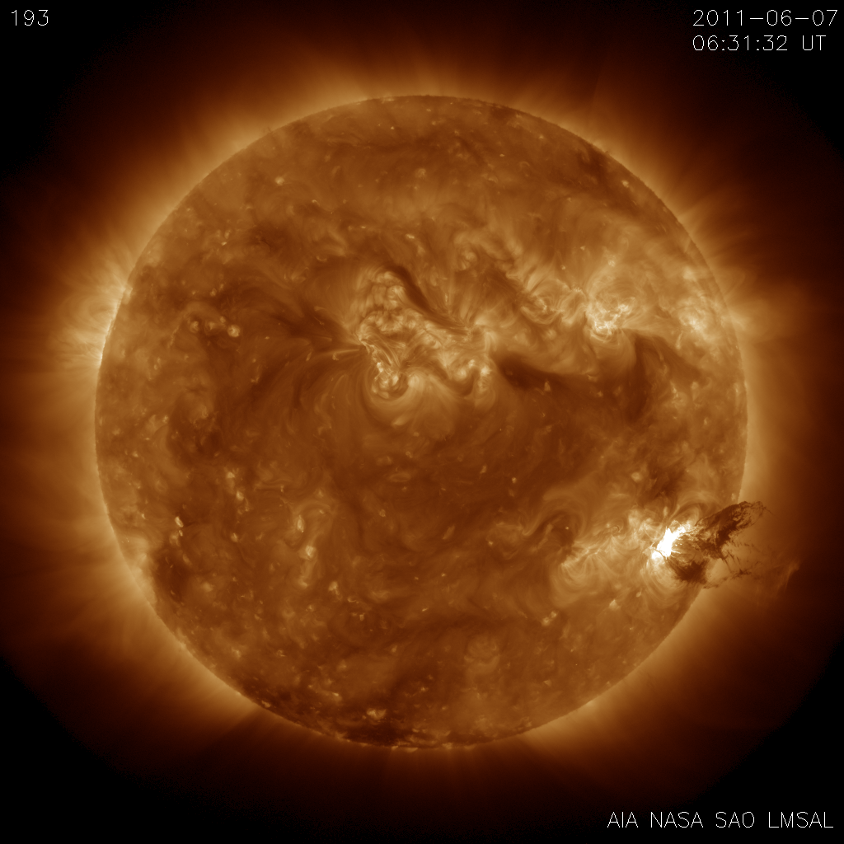
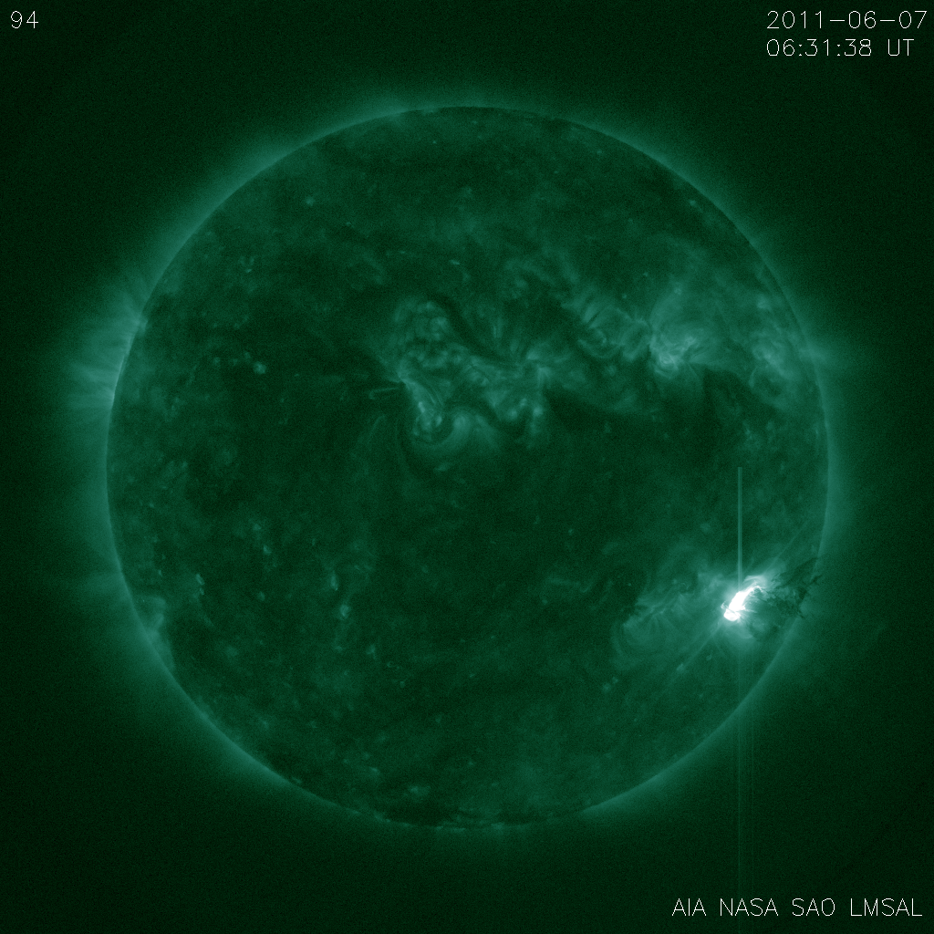
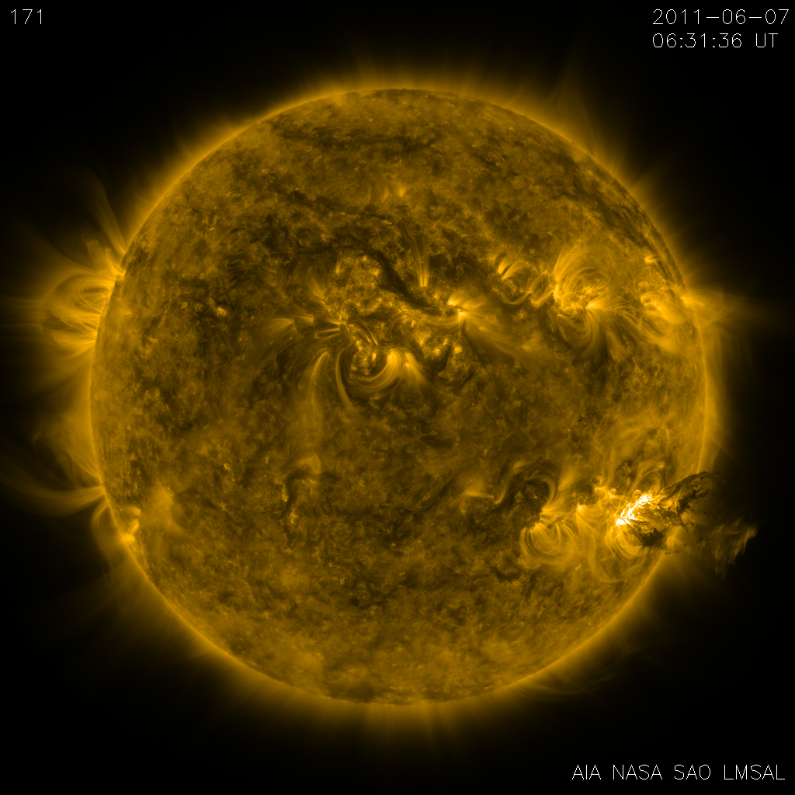
Atmospheric Imaging Assembly
Aboard SDO, launched 2010
EUV Imager
10 Channels, log(T)~3.7-7.2
4096px, 0.6’’/px
12s Cadence
Nearly 60K images per day
1+ TB/day (SDO)

Slide 9
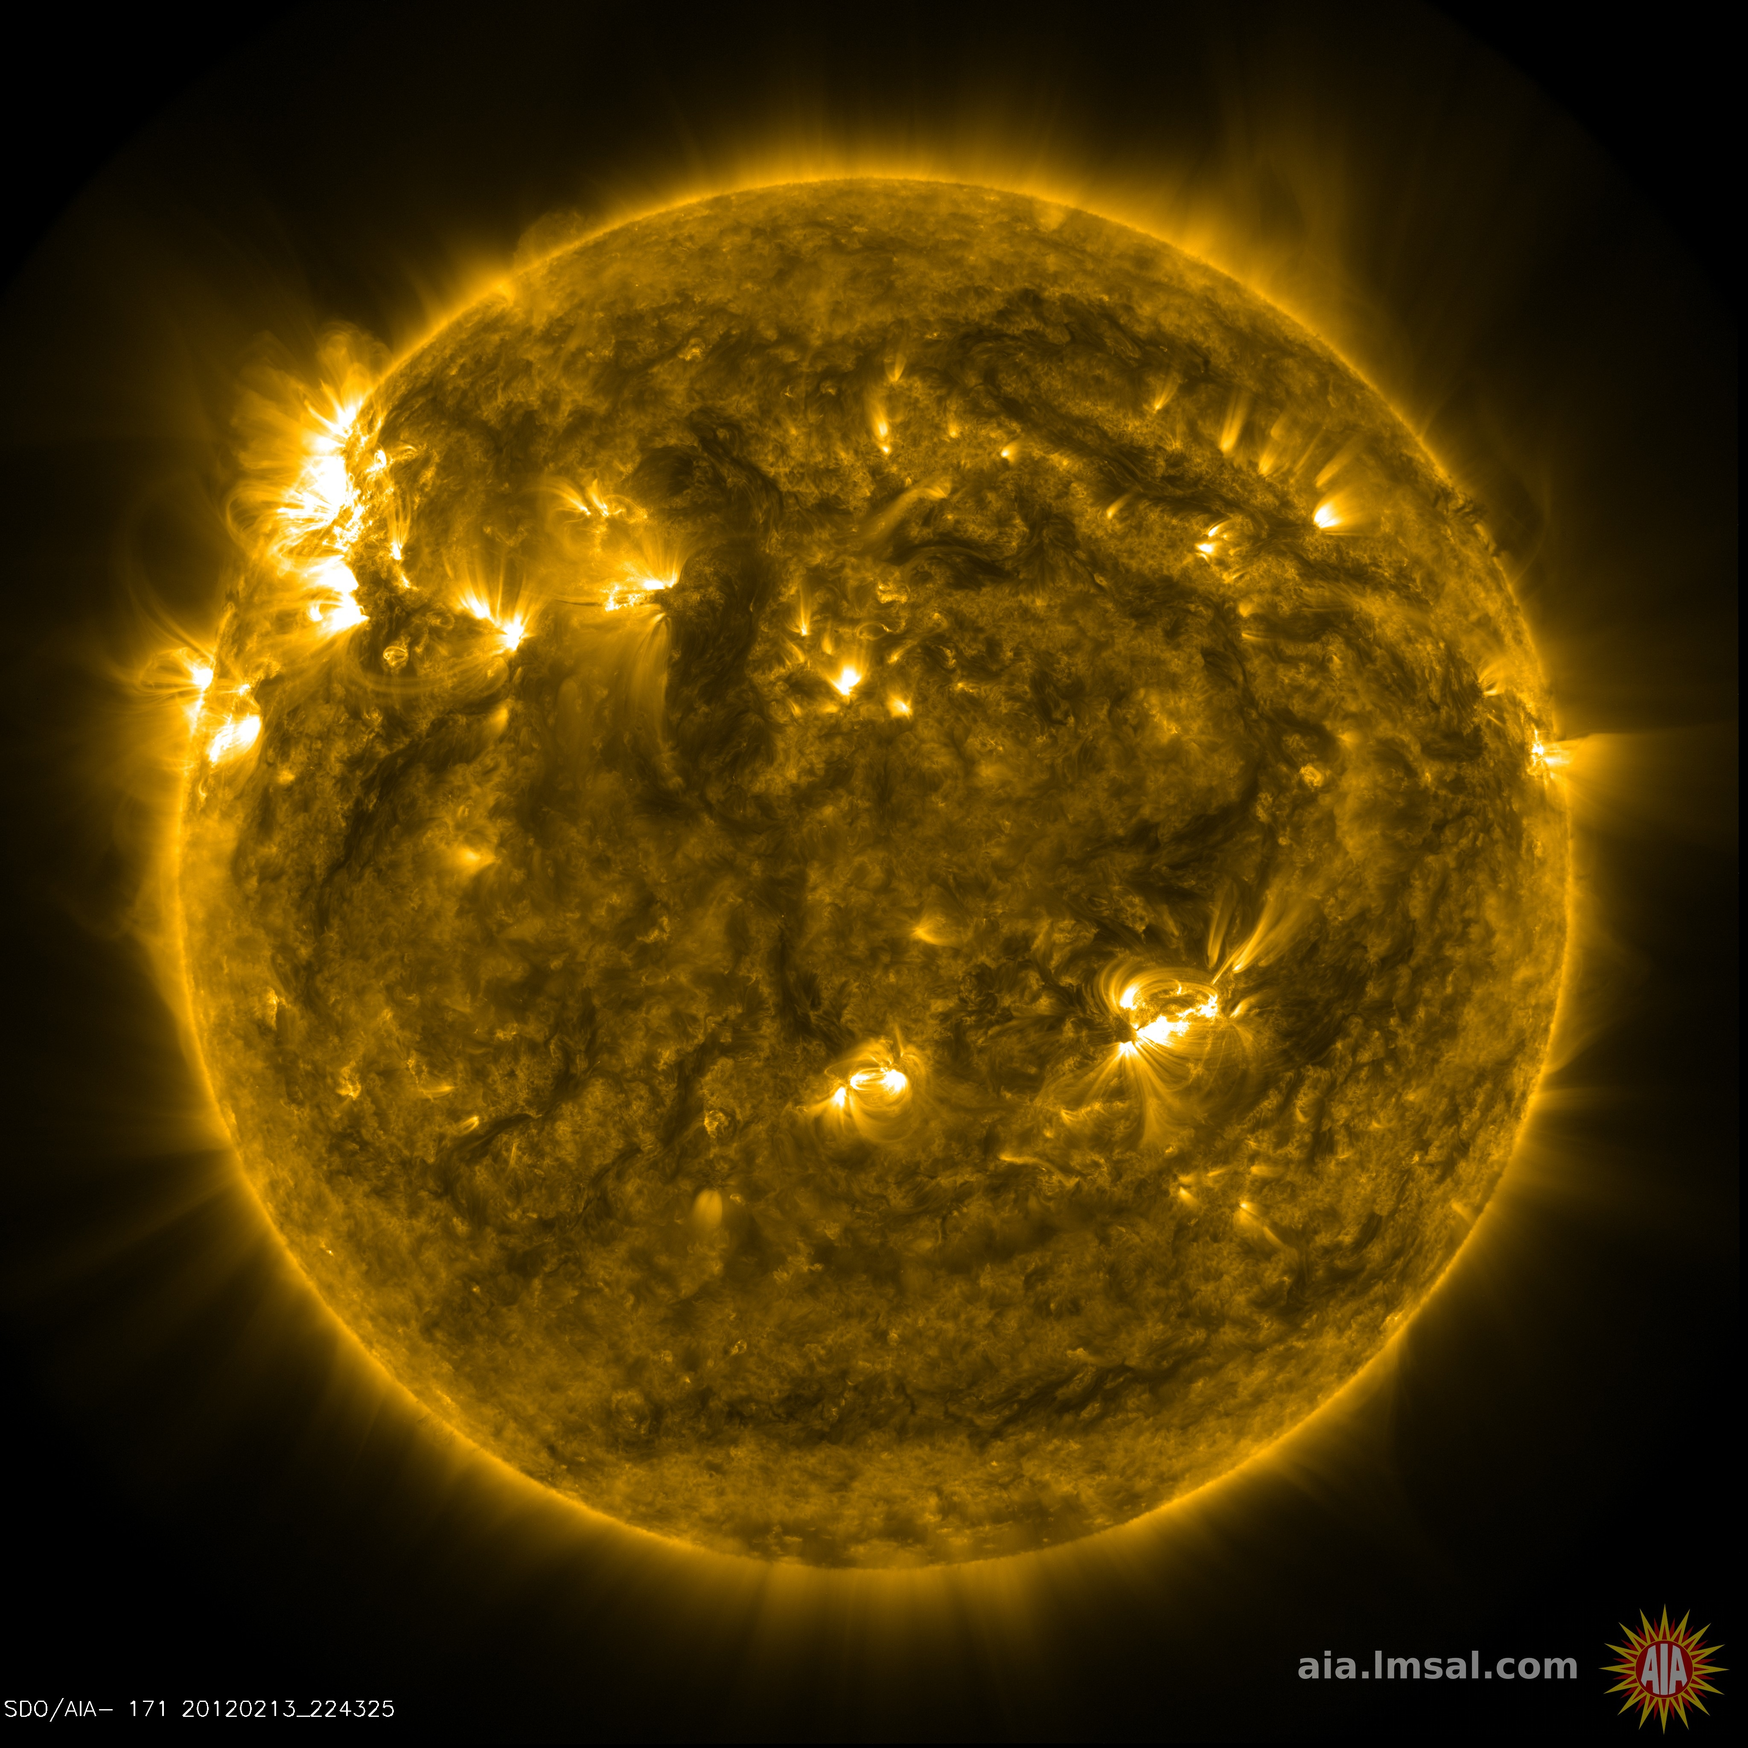

Slide 10
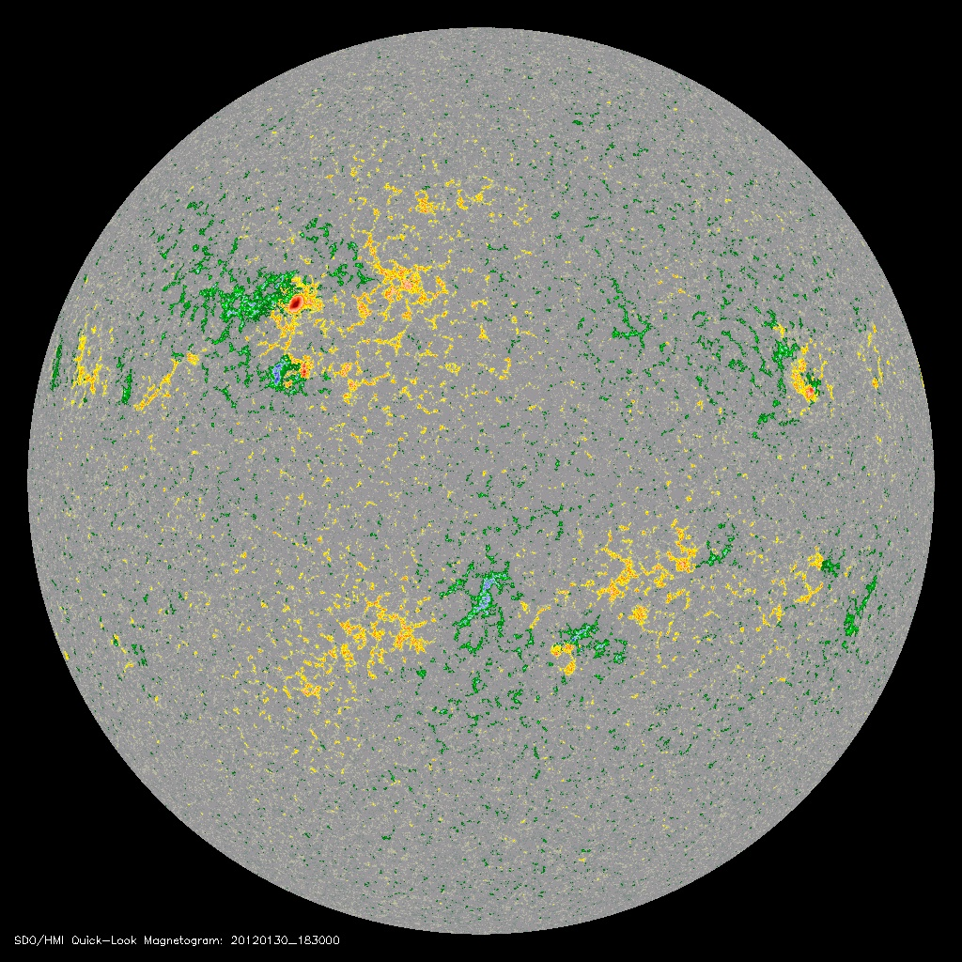
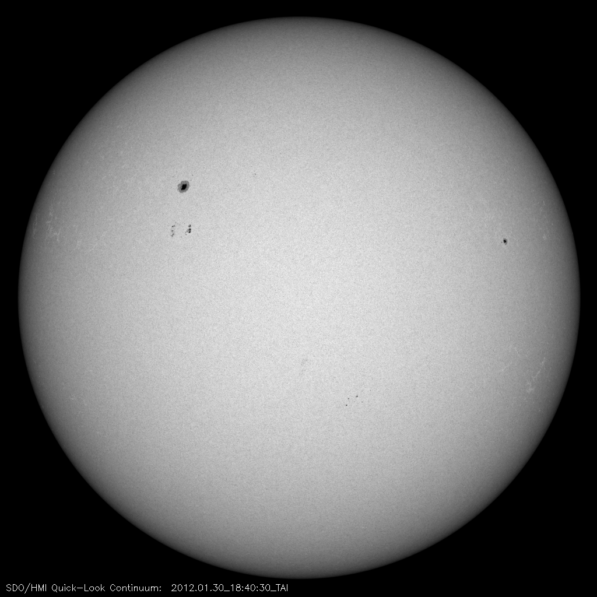
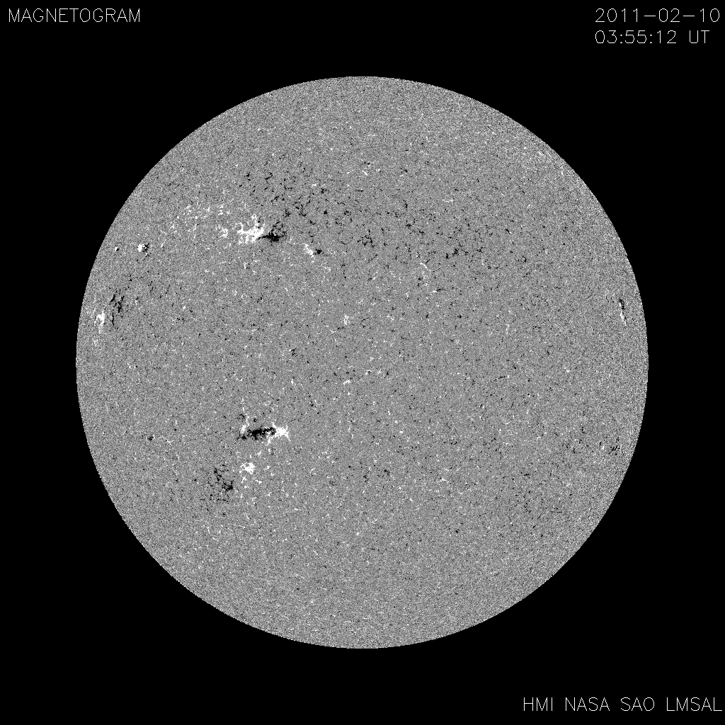
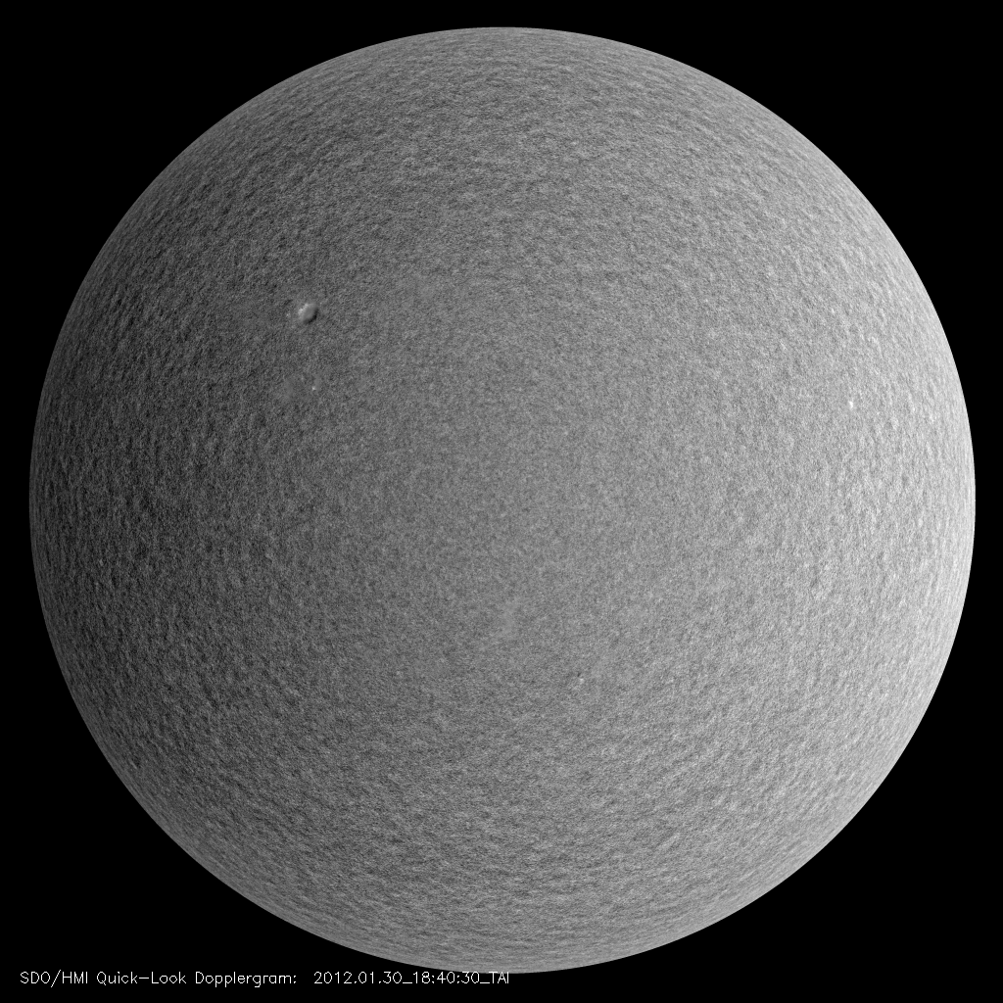
Helioseismic and Magnetic Imager
Aboard SDO, launched 2010
Multiple Filter Imager
Maps of surface LOS velocity & magnetic field
4096px, 0.5’’/px
45 or 90s Cadence

Slide 11
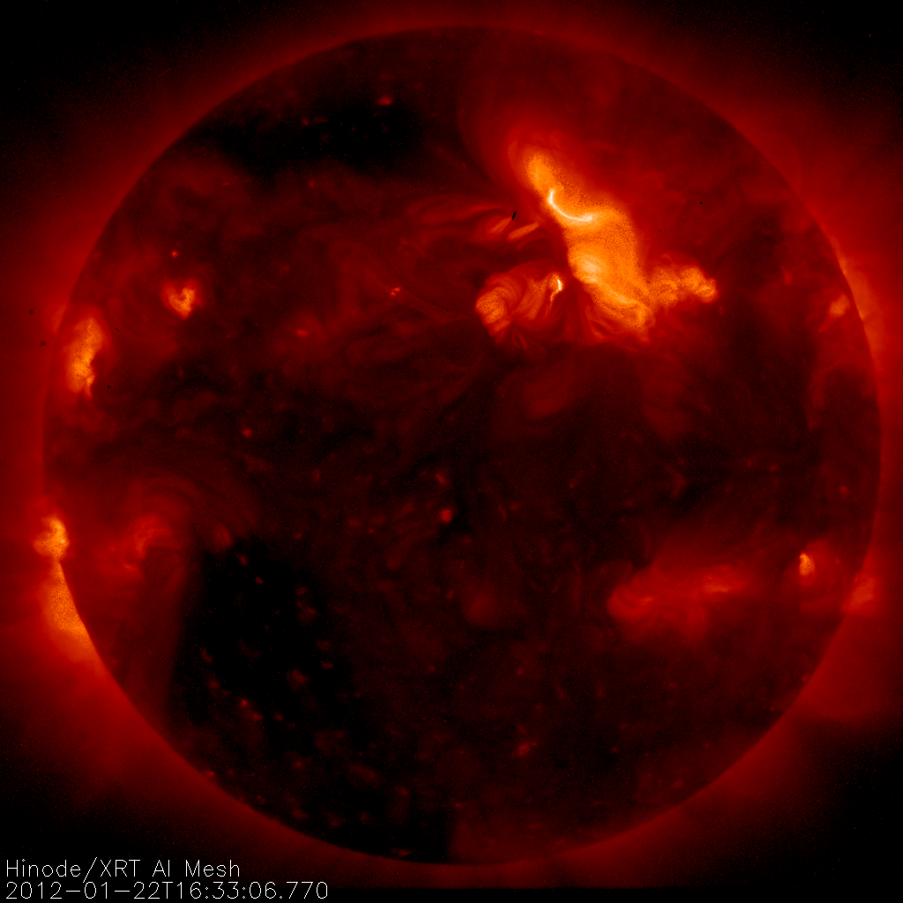
Hinode X-Ray Telescope
Aboard Solar B, launched 2006
X-Ray Imager
9 Filters, log(T)~5.5-9
2048px, 1’’/px
Various cadences, observations
~ 1 Gbit/day

Slide 12

Interface Region Imaging Spectrograph
Launched June 2013
Imager and Spectrograph
4 Wavelengths in SJI (1330, 1400, 2796, 2832)
NUV and FUV SG
175” slit length
Various cadences, observations

Slide 13
Online Resources Tour

Slide 14
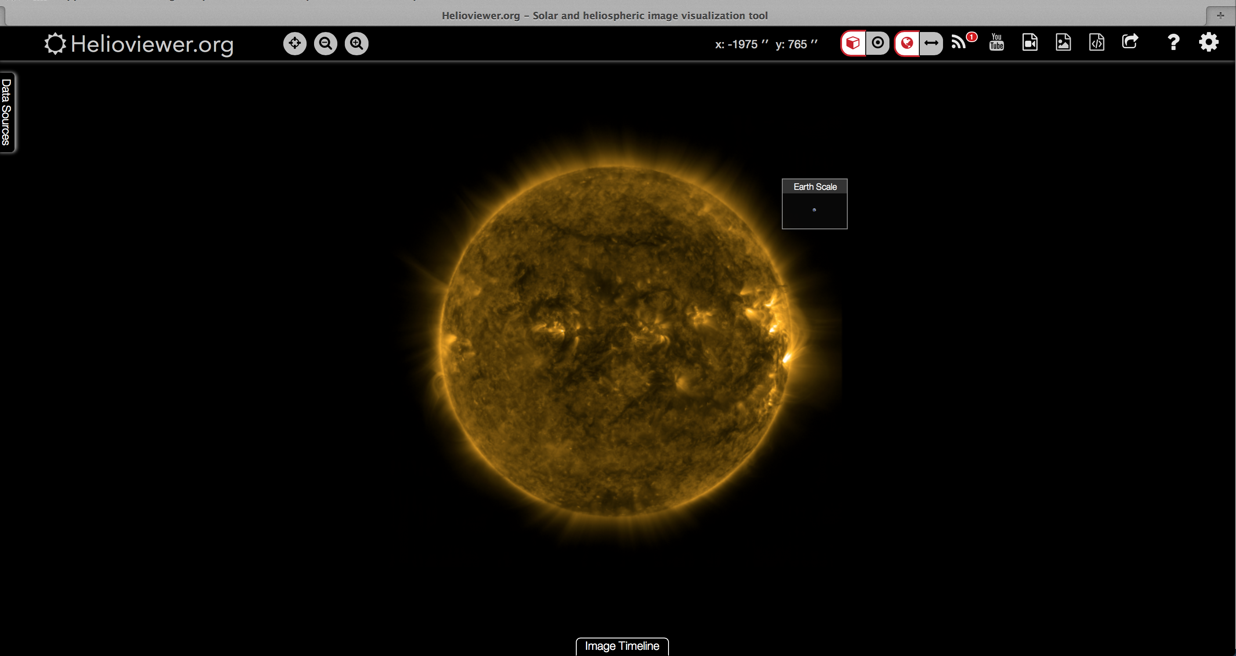
Helioviewer

Slide 15
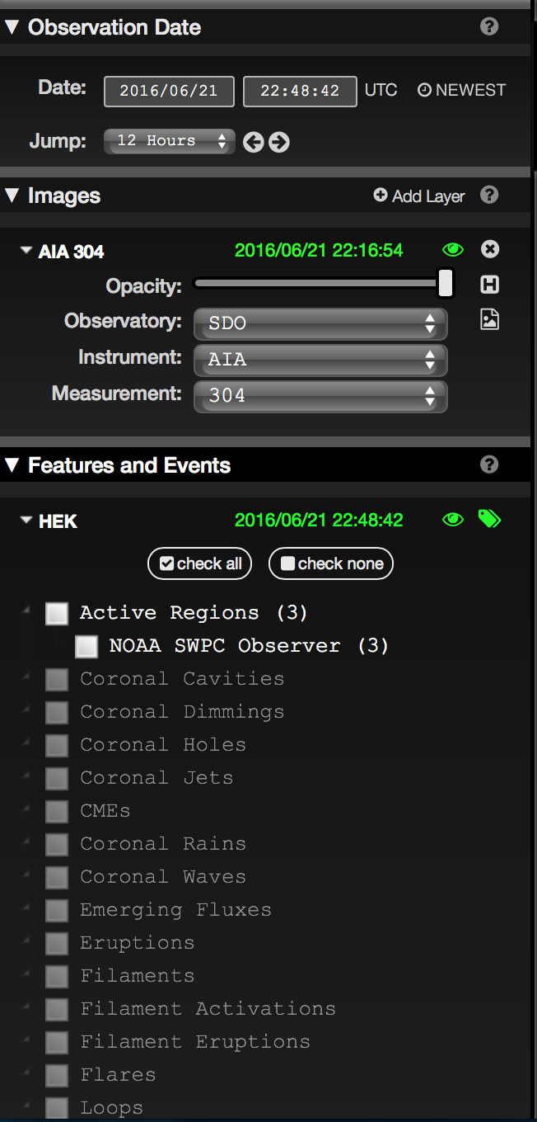
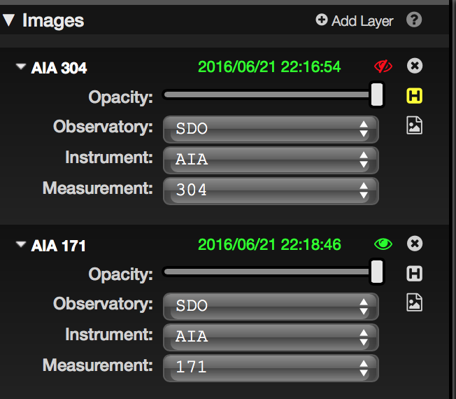
Helioviewer

Slide 16
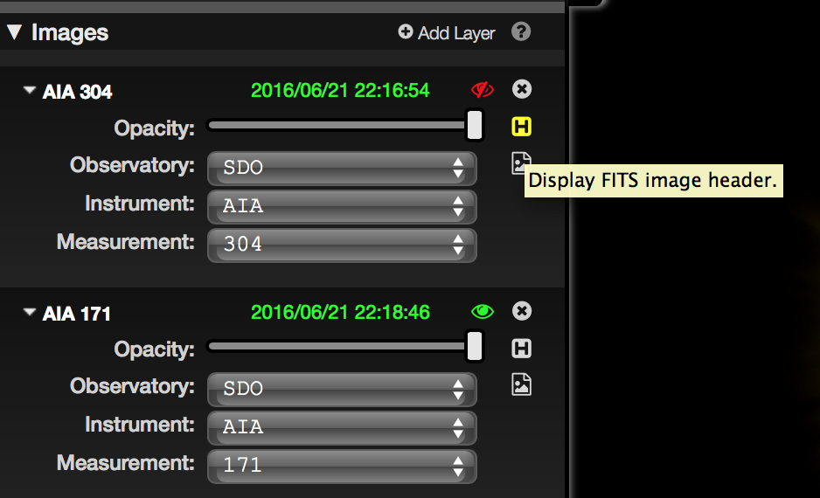
Helioviewer

Slide 17
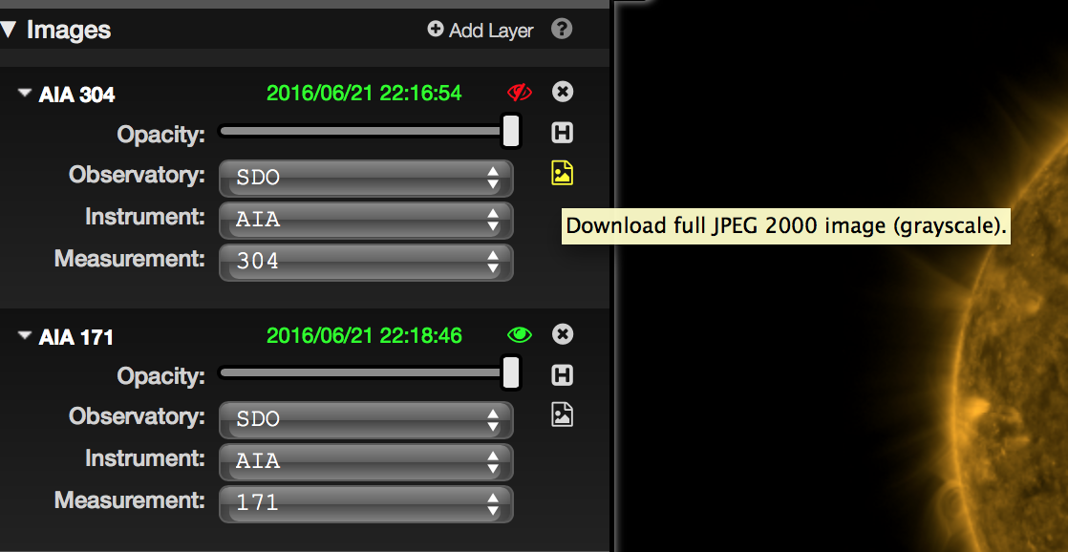
Helioviewer

Slide 18
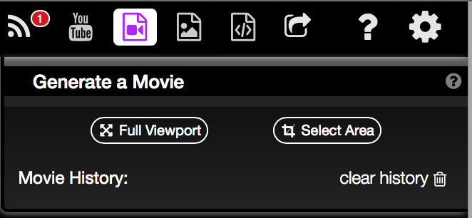
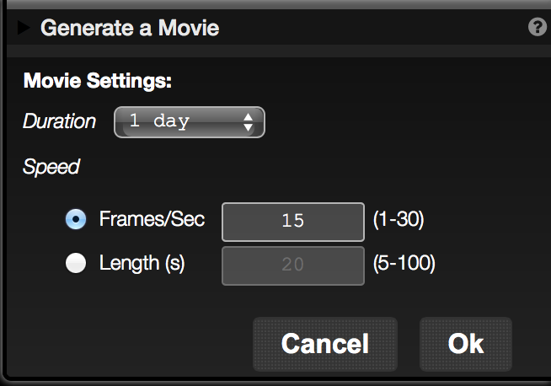
Helioviewer

Slide 19
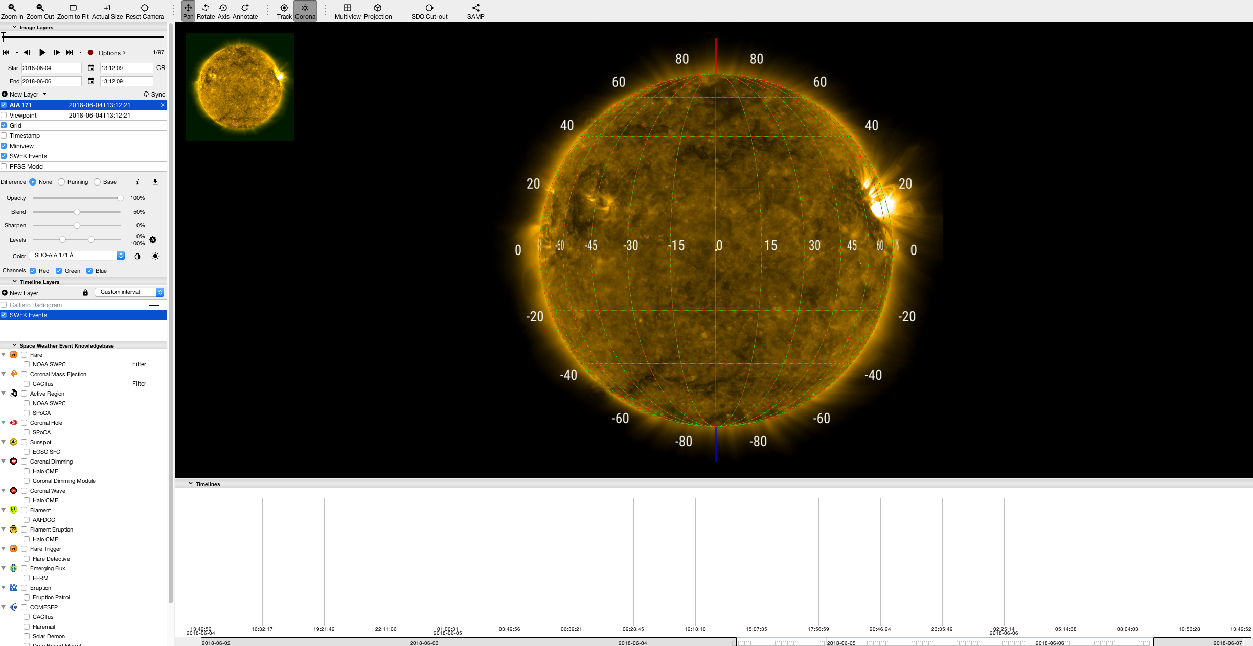
Jhelioviewer (2.13.3)

Slide 20
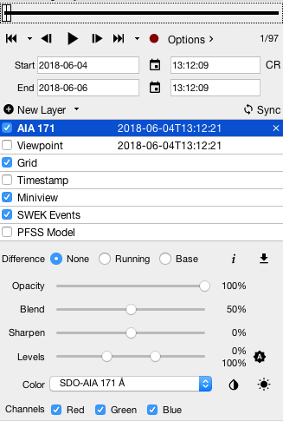
JHelioviewer
Record as a movie
Great for viewing movies of data quickly
Many settings to play around with
Blends stacked images (set to 0 for 3 color)
Allows for 3 color images

Slide 21
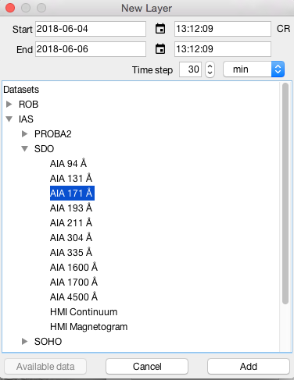
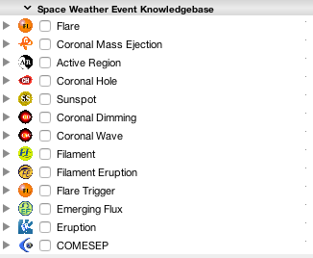
JHelioviewer
Add new lay by clicking File in the menu and selecting new image layer

Slide 22
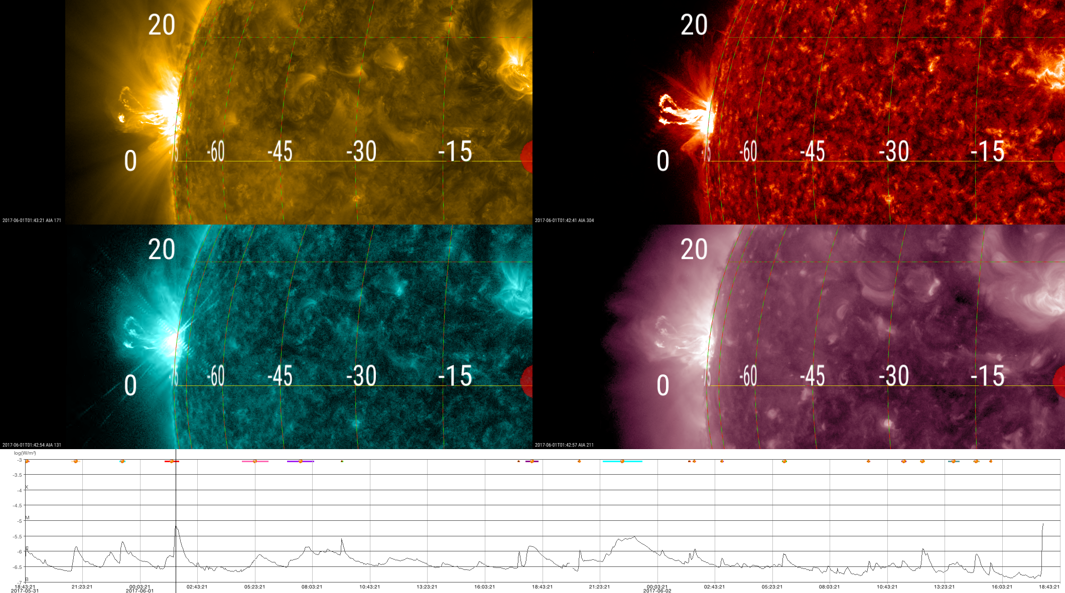
JHelioviewer (2.13.3)

Slide 23



JHelioviewer
Old
New

Slide 24


Heliophysics Events Knowledgebase (HEK)
http://www.lmsal.com/isolsearch

Slide 25

HEK Summary
Date Range
Sample Image
Symbolic Events
Event Selection
Movie
Get Data
List of Events
Symbol Key

Slide 26

“Get SDO Data” Link From HEK
Notes:
The Rice version is just a compressed file.

Slide 27

Browser for XRT Data
Simply type “browser” (with out the quotes) in terminal window to get this window:

Slide 28


Browser for XRT Data

Slide 29

Browser for XRT Data

Slide 30

Browser for XRT Data

Slide 31

Browser for XRT Data

Slide 32


Browser for XRT Data

Slide 33

Browser for XRT Data

Slide 34

Browser for XRT Data

Slide 35

Browser for XRT Data

Slide 36

Browser for XRT Data

Slide 37
Browser for XRT Data

Slide 38

Browser for XRT Data

Slide 39

Browser for XRT Data

Slide 40

Browser for XRT Data

Slide 41

Browser for XRT Data

Slide 42

Browser for XRT Data

Slide 43

Searching for IRIS Data

Slide 44

Searching for IRIS Data

Slide 45

Searching for IRIS Data
IDL>iris_xfiles

Slide 46



Searching for IRIS Data (Cont.)
SJI
Raster

Slide 47
Local Data
An example path to get AIA data:
/data/SDO/AIA/level1/2012/04/28/H1700
Could also get HMI or EVE data under /data/SDO
An example path to get XRT data:
/archive/hinode/xrt/level0/2010/09/06/H0300
An example path to get IRIS data:
/data/IRIS/level2_nrt/2016/06/14/20160614…

Slide 48

Virtual Solar Observatory (VSO)
Tool to acquire solar data sets
Web or IDL interfaces to search and download data
Many different types of data from many different instruments
http://sdac.virtualsolar.org/cgi/search

Slide 49

VSO Example Search
Search by:
Date/Time and Instrument

Slide 50

VSO Example Search

Slide 51

VSO Example Search
Notes:
The Rice version is just a compressed file.

Slide 52

VSO Example Search

Slide 53
VSO IDL Interface
IDL> search_var = vso_search()
IDL> get_var = vso_get(search_var)
Example:
IDL> aia_data = vso_search(date='2012/1/27T00:00 - 2012/1/27T00:01’, inst='aia', wave='171 Angstrom')
IDL> dl_aia = get_var(aia_data, out_dir=‘/home/jakubprchlik/vso_data/’)
Helpful links for syntax and functionality
Search Data: http://docs.virtualsolar.org/wiki/VsoIDL/VsoSearch
Get Data: http://docs.virtualsolar.org/wiki/VsoIDL/VsoGet

Slide 54
VSO python Interface
Example 1:
python> from sunpy.net import vso
python> import astropy.units as u
python> client = vso.VSOClient()
python> start= “YYYY/MM/DDTHH:MM:SS”
python> end = “YYYY/MM/DDTHH:MM:SS”
python> time= vso.attrs.Time(start,end)
python> ins = vso.attrs.Instrument(‘aia’)
python> wave= vso.attrs.Wave(171*u.AA,171*u.AA)
python> qr1 = client.query(time,ins,wave)
python> res = client.get(qr1,path=‘/download/path/’)
Example 2:
python> import drms
python> client = drms.Client(‘youremail@email.com’)
python> start= “YYYY.MM.DD_HH:MM:SS”
python> end = “YYYY.MM.DD_HH:MM:SS”
python> expt = client.export(‘iris.lev1[{0}_TAI-{1}_TAI][][]’.format(start,end))
python> exp.download(‘/download/path/’,index,fname_from_rec=True)
Documentation for Python Modules
Sunpy (example 1) :
http://docs.sunpy.org/en/stable/guide/acquiring_data/vso.html?highlight=vso
Drms (example 2): http://drms.readthedocs.io/en/stable/
Register Email: http://jsoc.stanford.edu/ajax/register_email.html

Slide 55
Basic Data Prep
AIA Example
Read in the data
IDL> read_sdo, filename, index, data
Example
IDL> read_sdo, ‘AIA20130607_175958_0131.fits’, header, image, /silent, /uncomp_delete
Prep the data
IDL> aia_prep, index_in, data_in, index_out, data_out
Example
IDL> aia_prep, header, image, new_header, new_image
IRIS and XRT Example
IDL>read_iris,'/data/IRIS/level2_nrt/'+year+'/'+month+'/'+day+'/'+obsinfo+'/iris_l2_'+obsinfo+'_SJI_'+wav+'_t000.fits',index,rdata
IDL>iris_prep,index,rdata,oindex,odata
IDL>readcol,filelist,fitsfiles,format='A’
IDL>all = indgen(n_elements(fitsfiles)-1)
IDL>xrt_prep,files,all,index,data,/float,coalign=0,/despike_despot,spotthresh=-1,/quiet
To learn more about these (or other) programs in the SSWIDL library- what they do, keywords, syntax, etc.:
IDL> xdoc, “program name”
…or locate the program file and view.

Slide 56
Thank you!

Slide 57


Sun Today
http://sdowww.lmsal.com/suntoday/

Slide 58

Sun Now
http://sdo.gsfc.nasa.gov/data/

Slide 59

Solar Monitor
http://www.solarmonitor.org
Notes:
Also show Jan 27th and click on the C7.9 flare to show gif animation of a CME from LASCO.

Slide 60

Solar Monitor

